Slide 1
OOPs in Python
Shah Ayub Quadri
aquadri@digital-lync.com

Slide 2

Index
OOPs in Python
• Method overloading and overriding
• Overriding
• Overloading

Slide 3

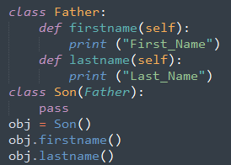
Method overriding and overloading
Method Overriding :
·It is the ability of a class to change the implementation of the methods provided by one of its parent classes.
· Example:
· Lets us take an example with overriding and without overriding in python.
· Take an example on inheritance.
· Here we accessed method using son class even though we haven’t declared in son class using inheritance..

Slide 4
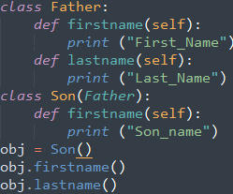

Method overriding and overloading
With Overriding :
· Here we declared a method in Son class with same method name that in the Father class.
· Now when we try to access Son class method name it will print statement in so class because it will override the previous existing parent method name.
· This method of overriding the previous existed method with the new method is called Method Overiding.

Slide 5
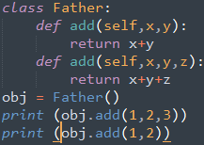

Method overriding and overloading
Method Overloading :
· Python does not support method overloading because python is dynamically typed language and therefore method overloading like in c,c++ is not supported in python.
Example:
· Here we have two method with same name but different number of arguments.
· Considering java/c++ above code is correct but in python we can call only the latest implementation.

Slide 6
Method overriding and overloading
· Here if we call the add method with 3 arguments we will get addition of all three arguments as the result.
· If we tried to call add method with 2 arguments it will show an TypeError even though we have add method with two arguments.
· This is because if we have two or more methods with the same name python only understand the latest implementation of that method . Similarly it check the type of arguments passed.
· In python we don’t want to keep the argument type as it is dynamic.
· Now if we change the order of 2 methods then we can call method with 2 arguments.

Slide 7
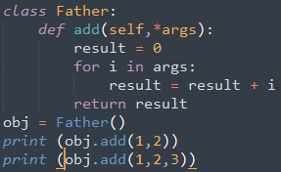

Method overriding and overloading
· In python if we want have a method which takes variable number of arguments we can use arguments or keyword arguments as parameters.
Example:
· Here we used *args which pass any no of arguments to a method.
· We the method is called with different arguments it will show the result and no error will be displayed.

